Slide 1
Google Analytics
Quick Demo

Slide 2
Introduction
Google Analytics for Beginners shows new users how to create an account, implement tracking code, and set up data filters. You'll learn how to navigate the Google Analytics interface and reports, and set up dashboards and shortcuts. The course will also demonstrate how to analyse basic Audience, Acquisition, and Behaviour reports, and set up goals and campaign tracking.
  Lesson 1: Google Analytics setup
        Create a website
        Generate Tracking ID
        Place Tracking ID JavaScript code in your Website Pages.
  Lesson 2: Access the demo account

Slide 3
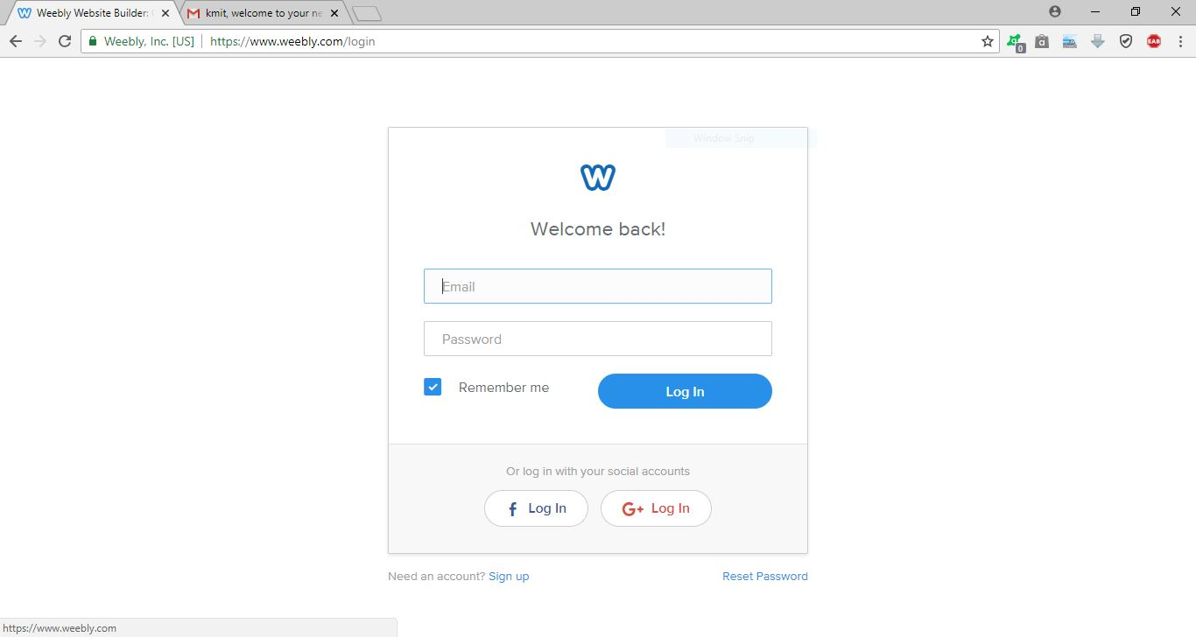
Creating a Website
To work on Analytics, One should have to Host a website.
  Here, we focus on creating a website.
  Weebly.com offering domains for free of cost, to host a website.
  A Quick demo to create a Website using weebly.com.
  Click on the following link.
  https://www.weebly.com/login

Slide 4
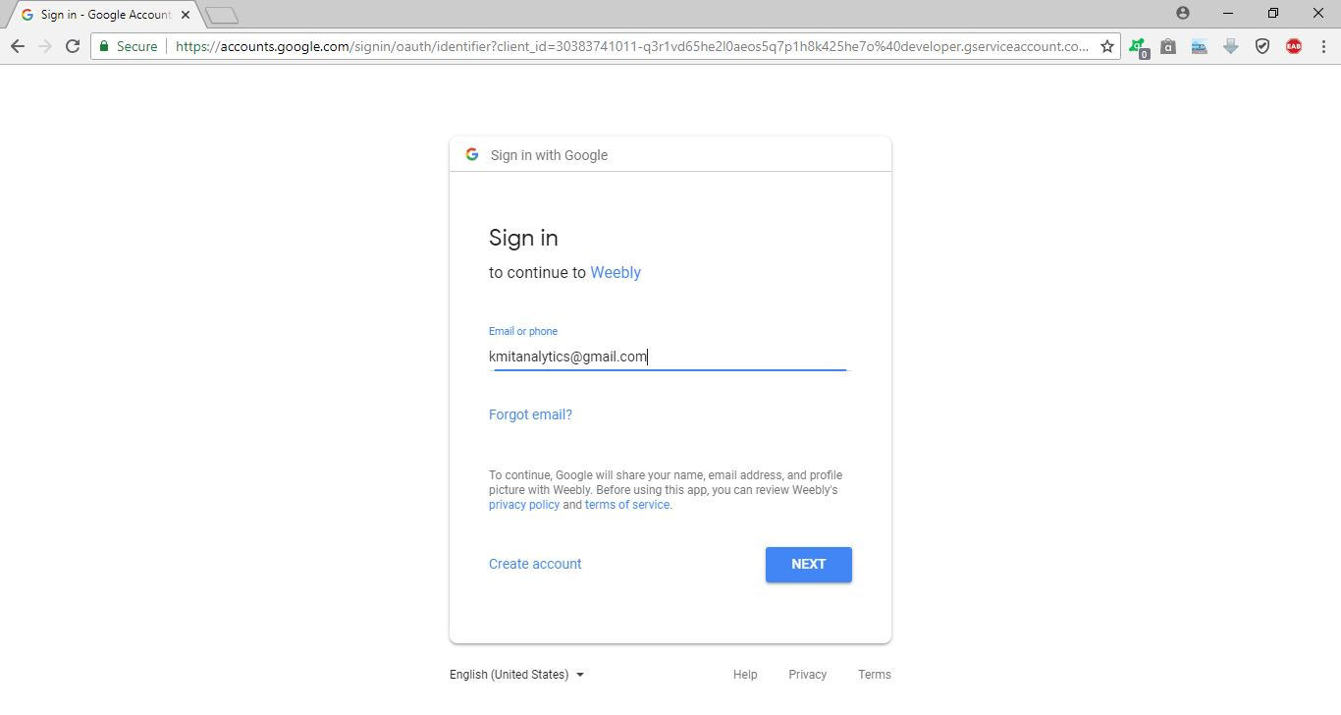
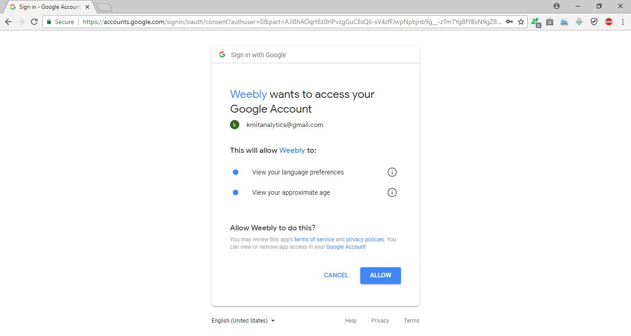
Cntd..
Login through Google Account.
Enter Username:
Password:
Give the permissions to weebly.
  Click on allow to Grant Permissions.

Slide 5
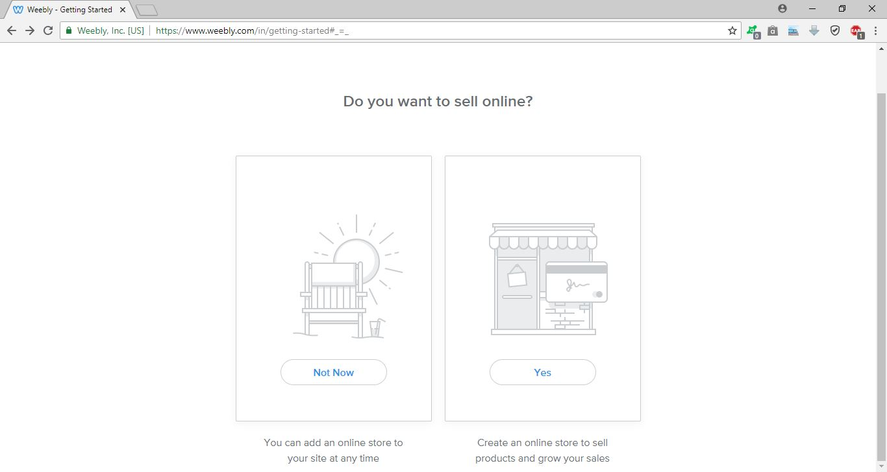
Cntd..
Now, select “Not Now”.

Slide 6


Cntd..
select “Theme”.
Shows Preview of Theme:
Click on ‘Start Editing’ button.

Slide 7
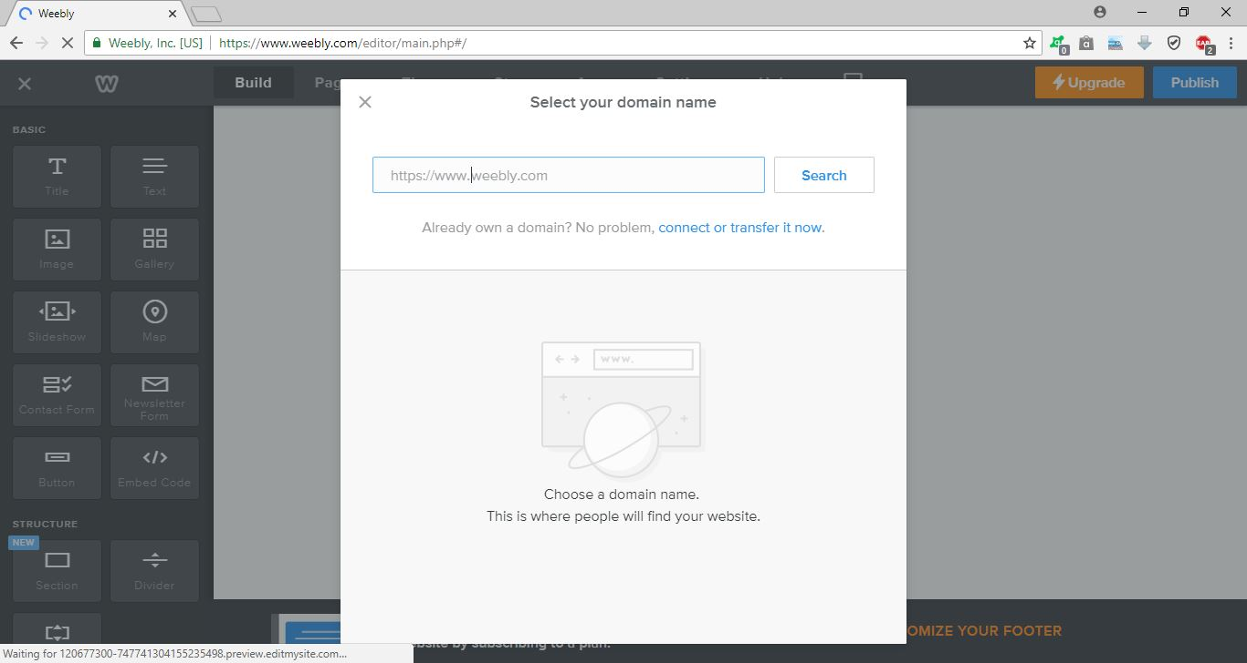
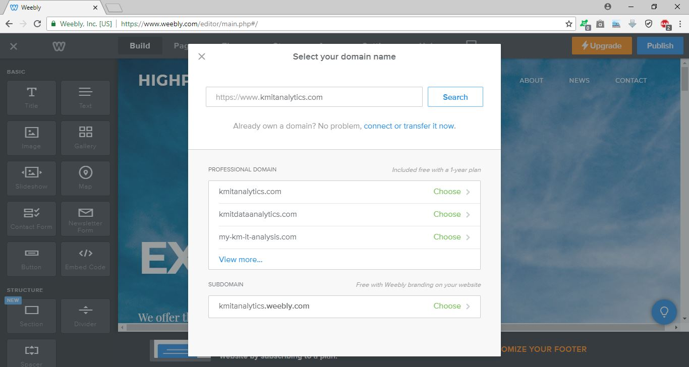
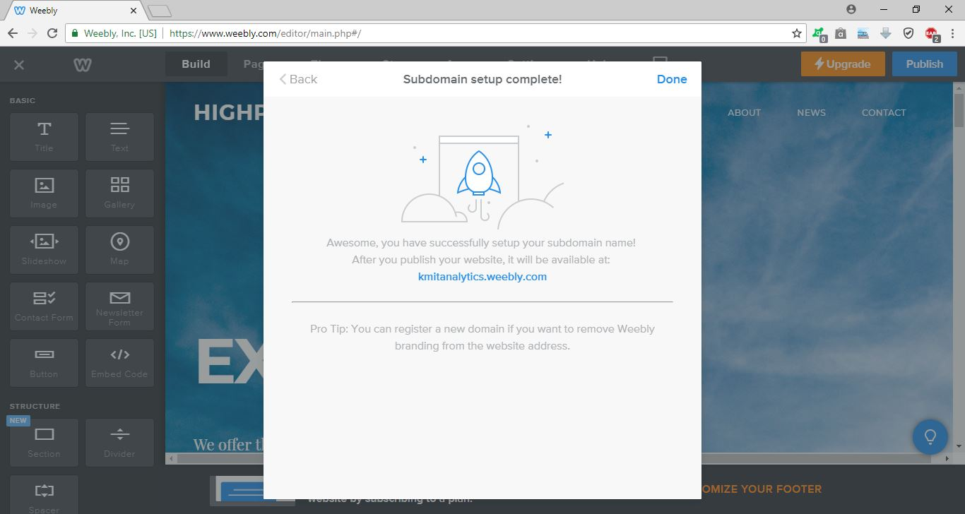
Cntd..
Provide the domain name
(Name of the website)
Select the sub domain and Confirm.
(It is free account).

Slide 8
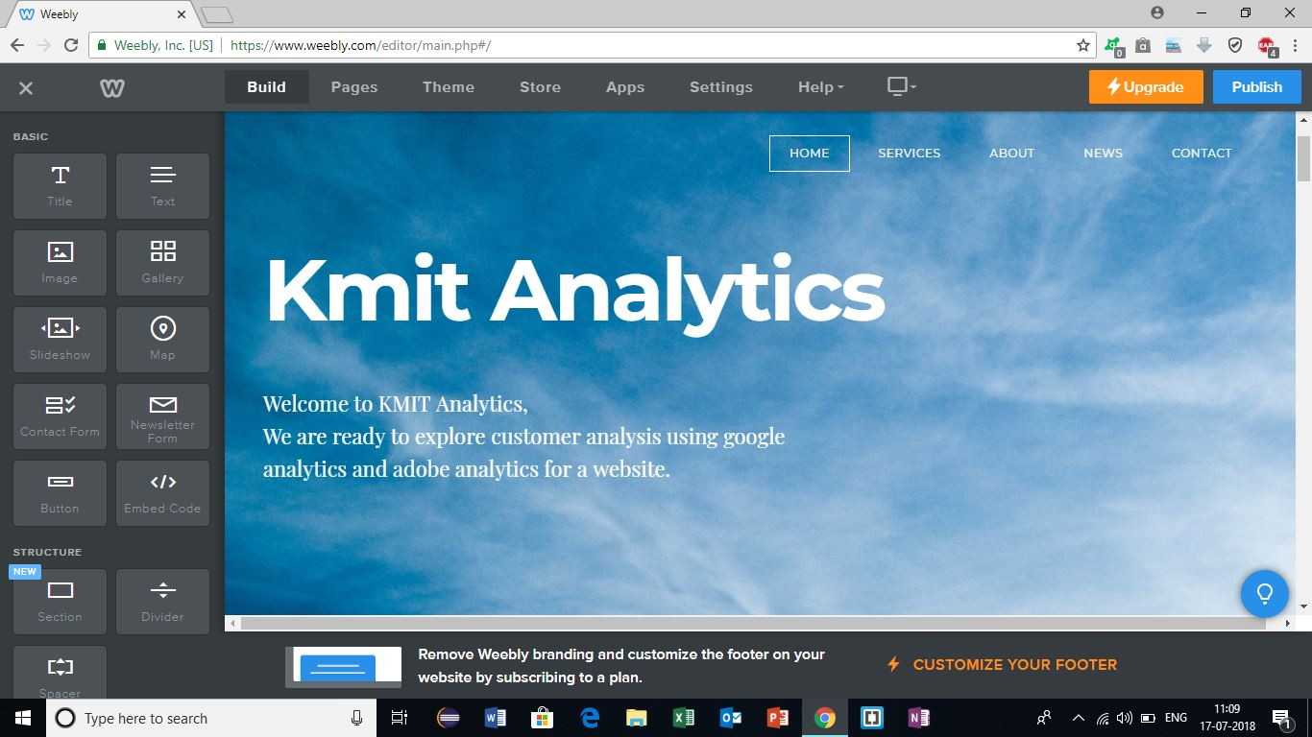
Cntd..
You can start editing your website.
There are some drag and drop options.

Slide 9
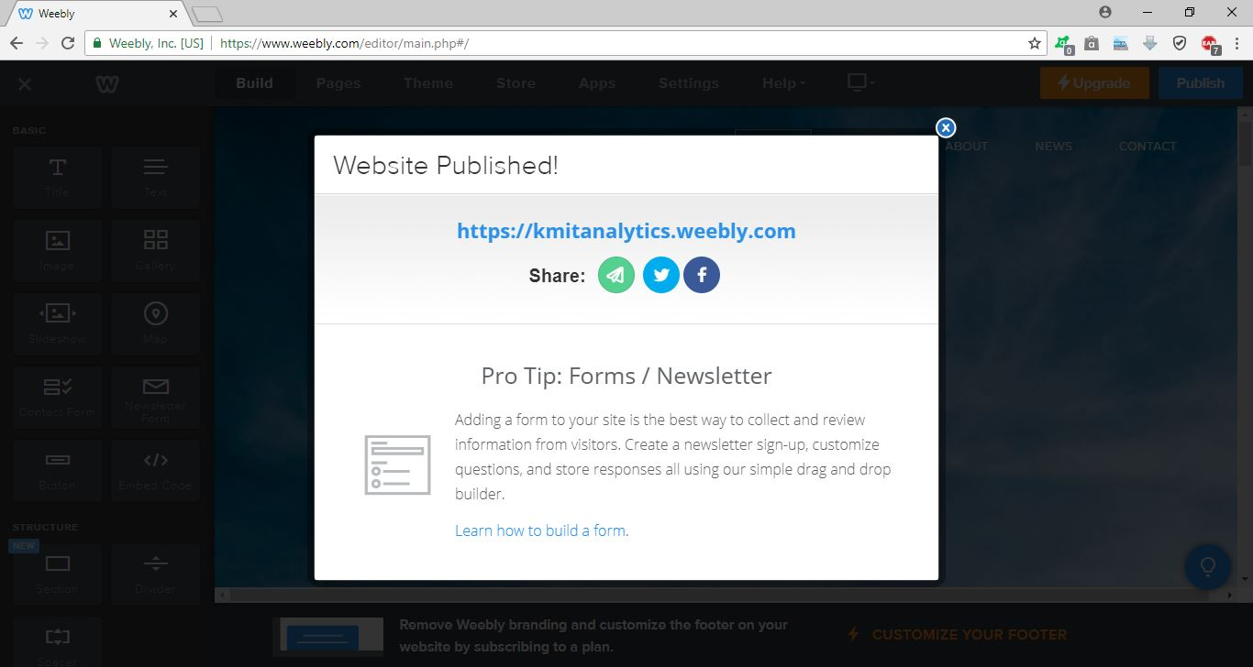
Cntd..
After editing , now we can click on ‘Publish’ the web site.
You will get this screen.
Now, goto the following URL to view your website.
https://kmitanalytics.weebly.com/

Slide 10
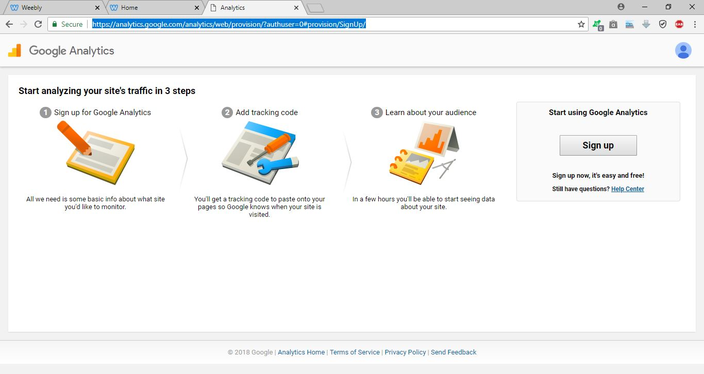
Generate Tracking ID
Now we are Ready to setup Google Analytics.
Login to your Gmail account.
Go to https://analytics.google.com
Click on “Sign up” and starts setup.

Slide 11
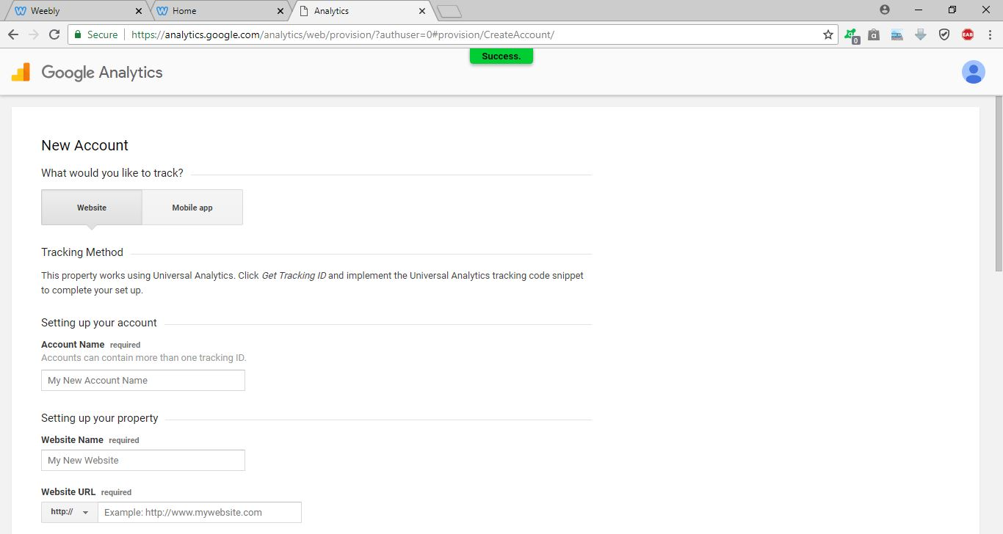
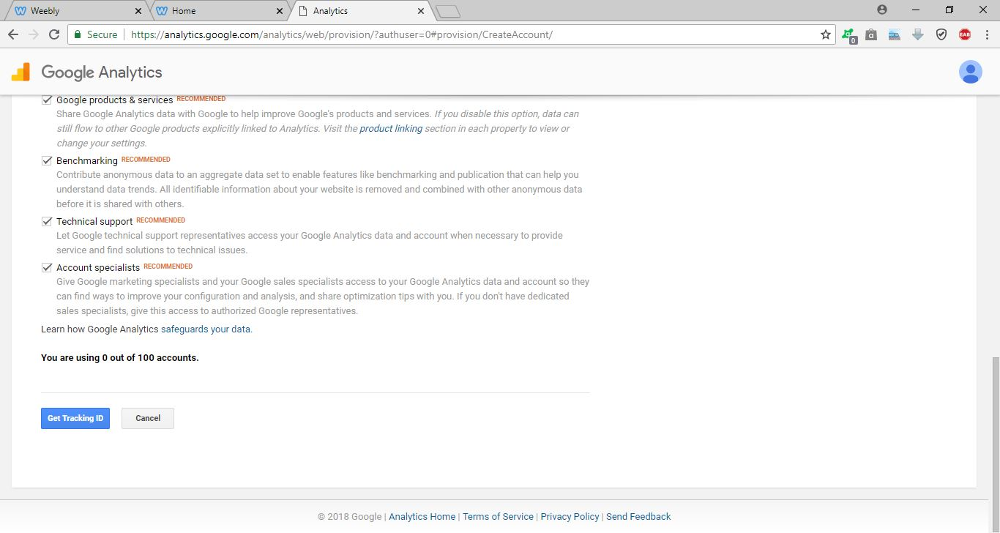
Cntd..
Fill the details:
  Account Name
  Website Name
  Website URL
    You can select the protocol type.
    http or https
  Select Category
  Select Time Zone
  Click on “Get Tracking ID”
  Select Country (India)
  Click on “I Accept” button

Slide 12
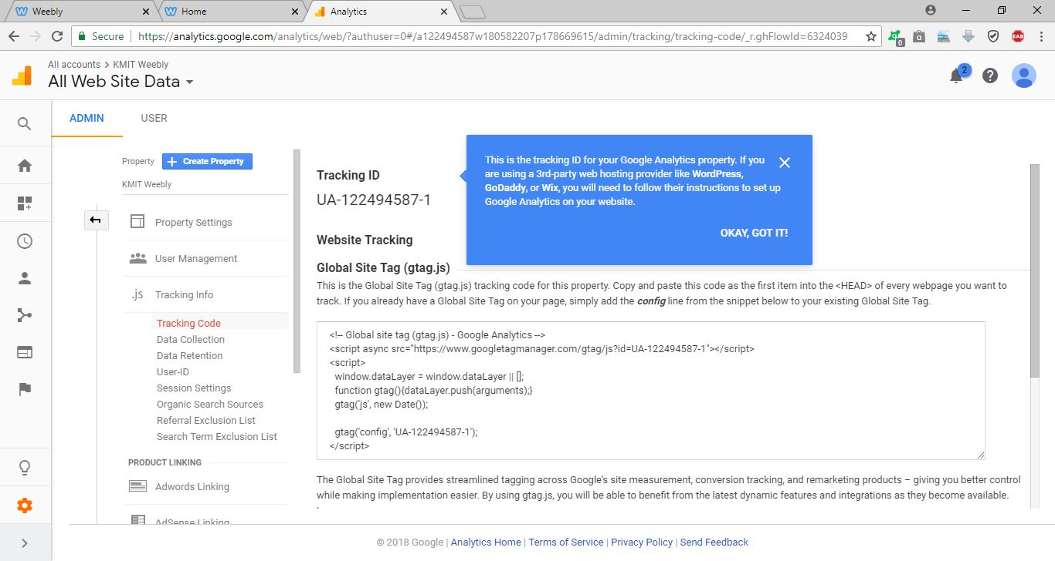
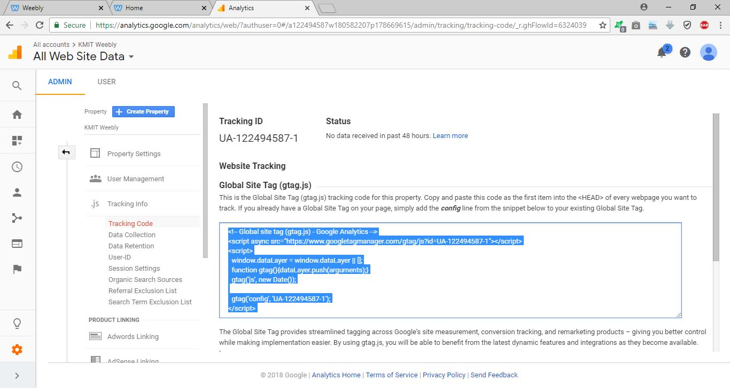
Cntd..
After Click on “I Accept”, You will get this page.
Copy the code and Save it in a Text File.

Slide 13
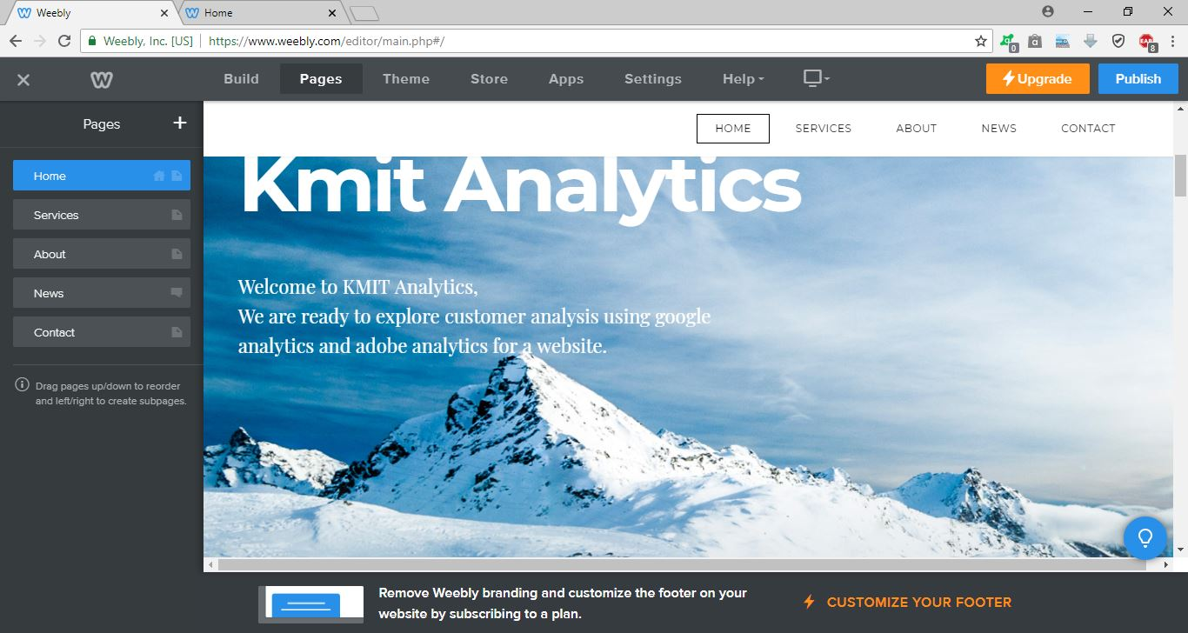
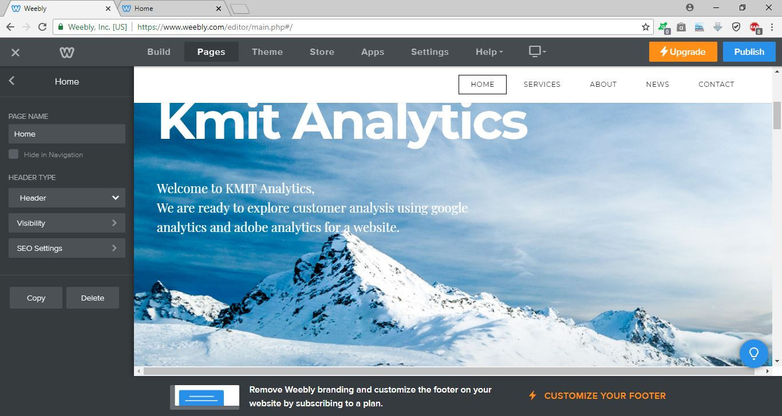
Place Tracking ID JavaScript code in your Website Pages.
Go to www.weebly.com,
Login to your account, then click on “EDIT SITE”
Go to “Pages” Tab.
Click on the page “Home”.

Slide 14
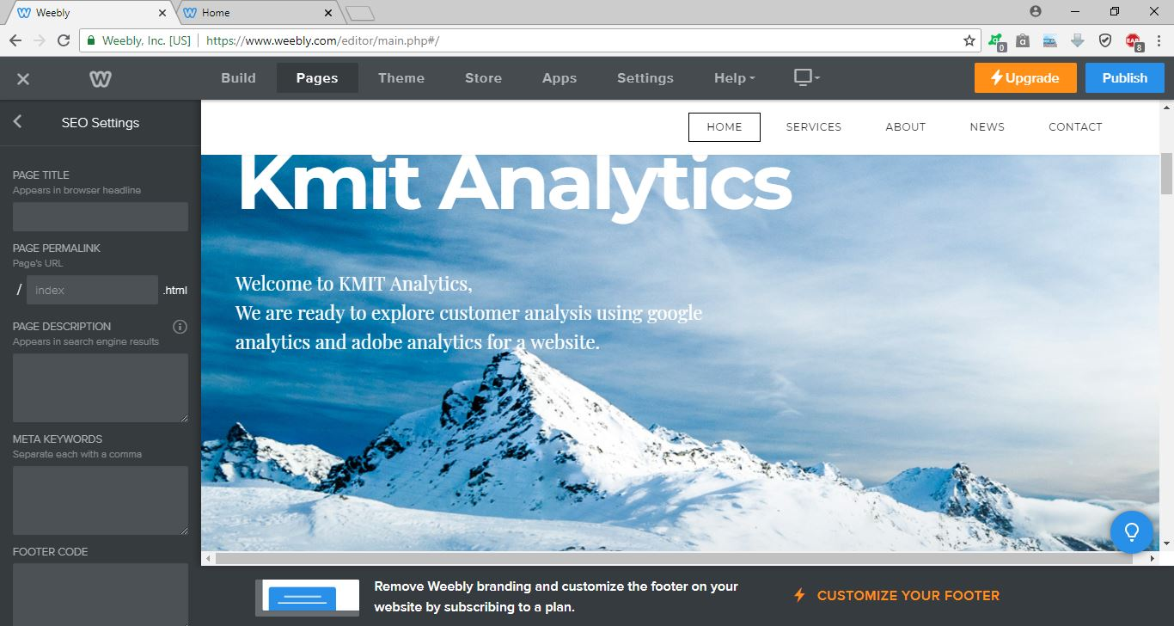

Cntd..
Go to SEO Settings.
  Navigate to “Header Code”
  Paste your Google Analytics Tracking Code
  Click on Publish.
Now, you are able to Track
  The “Home” page
Do the same
in Every page of your website.
NOTE: To check the modifications
You can view the source code.

Slide 15
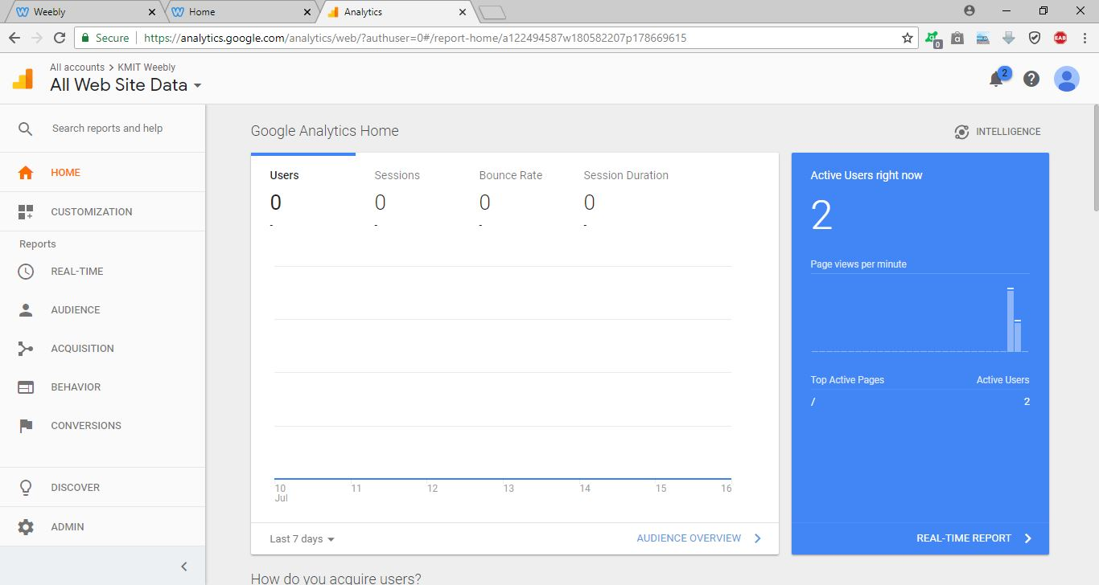
Cntd..
You are all set now to do Analytics.
Now open ‘analytics.google.com’
You can view the Google Analytics Home.

Slide 16


